Slide 1

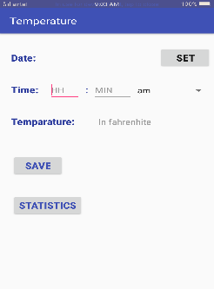
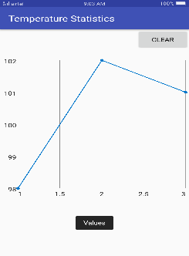
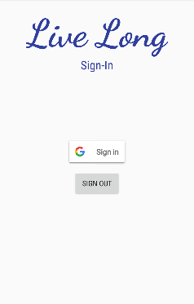
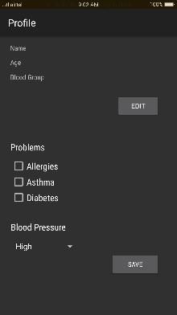
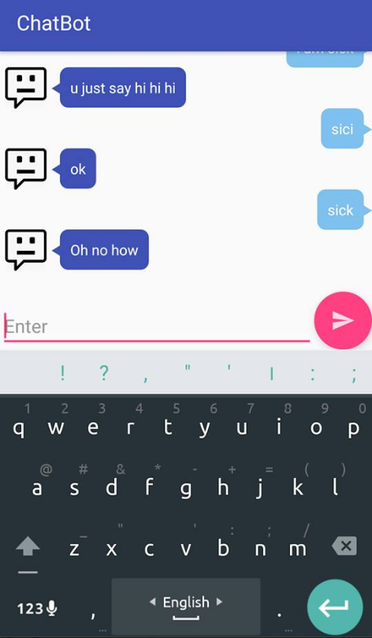
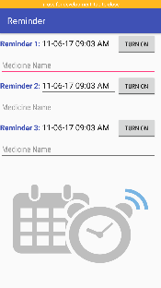
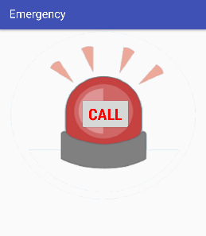
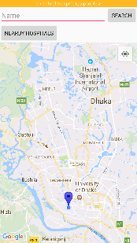
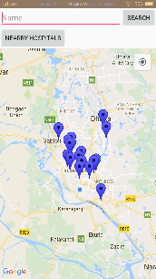
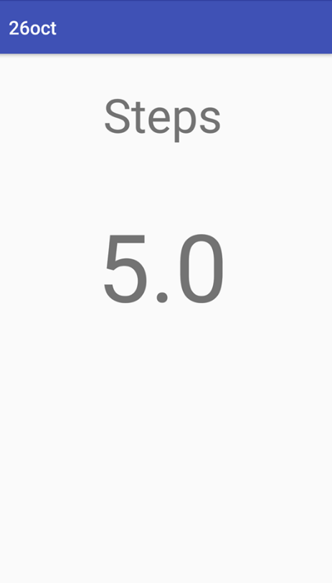
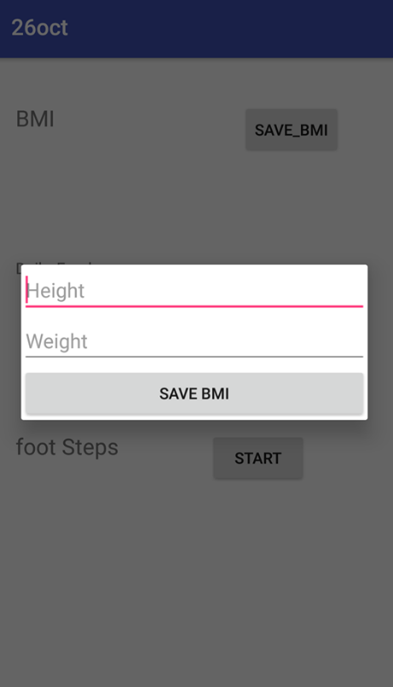
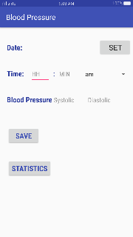
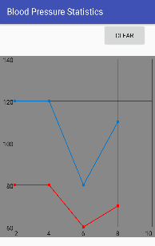
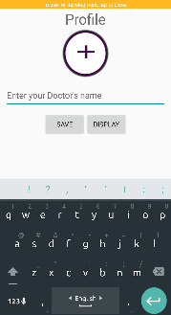
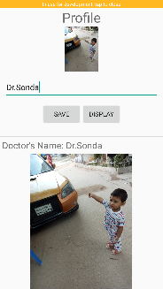
Live Long
Features
Reminder (Appointment & Medicine)
Emergency Contract
Nearby Hospitals
Temperature Records
Blood Pressure Records
Footstep Counter
BMI Counter
Prescription Store (through image)
Chatbot
Introduction
A digital assistive application to track records
Nearby Hospital
Reminder
Emergency Contract
Temperature records
Blood Pressure records
Temperature Update
User inputs time, date & temperature
Shows statistics by graph
Presented By:
Marzan Binte Abid (35)
Nowrin Hossain Neetu (39)
Md. Zaki Muzahid (97)
Nearby Hospital
Shows current location
Shows nearby Hospitals corresponding to current location
Chatbot
Dept. of Computer Science,
University Of Dhaka
Medicine Reminder
Generic bot conversation
User inputs date & time and medicine information
Reminds according to the input
Emergency Contract
User inputs desired phone number
Instantly calls the saved number
Blood Pressure Update
Check Up
User inputs time, date & pressure value
Shows statistics by graph
Stores prescriptions
Adds pictures
Footstep Counter
BMI Counter
Counts & stores number of footsteps
Countss BMI & shows if you are over or under weight

